Slide 1
Robot chassis design
The design we choose should be able to hold electronics components such as microcontrollers, sensors, battery and hold food we need to deliver.
One of the easiest designs to satisfy these requirements is TurtleBot, which has kind of table-like design.

Slide 2
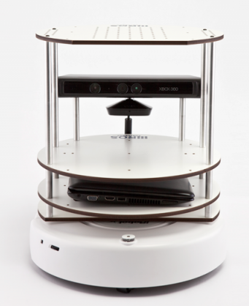
It has three layers in the chassis.
A robot platform called Roomba is the drive mechanism of this platform.
We are planning to design a robot similar to this with our own moving platform and components.
Moving platform will be designed as a differential drive system.

Slide 3
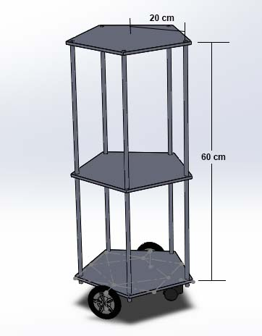
Designing Robot model
We did a Solidworks model for the Robot design we are planning to build.
For the plates we decided to go with Aluminum Composite Material boards because of their strength and light weight.
To connect plates we will be using threaded rods covered by aluminum tubes.

Slide 4
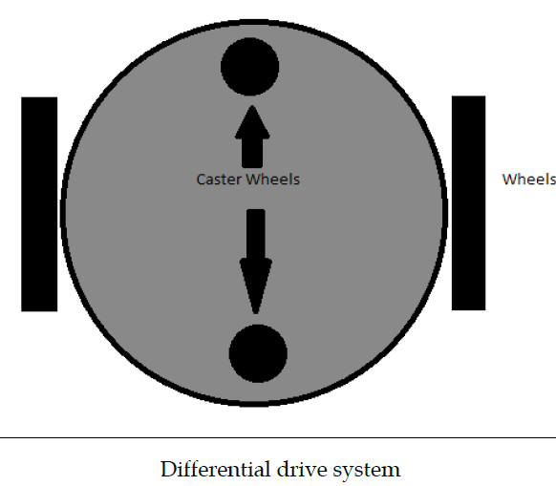
The choice of wheel types for a mobile robot is strongly linked to the choice of wheel arrangement, or wheel geometry.
One of the cost-effective solution for mobile robot navigation is differential drive systems.
Source : semanticscholor.org

Slide 5
Total Weight Estimation
Item | Weight
ACM Board for 0.378 𝑚² area | 1.52 𝑘𝑔
Threaded rods for 3.5 m | 2.2 kg
Kinect | 0.6 kg
Aluminum tubes | 0.4 kg
Wheels | 0.6 kg
Power Bank and Battery | 1.0 kg
Motors (NEMA 23) x 2 | 1.2 kg
Other Electronics | 0.5 kg
For foods | 1.0 kg
Steel Bottom plate | 0.8 kg
Total Weight | 9.83 kg

Slide 6
Calculation of motor torque
In our design we have 4 wheels and 2 motors.
Here we assume that the coefficient of friction is 0.6 and radius of wheel is 5 cm.
The weight acting on the four wheels can be written as,
N1 is the weight acting on each caster wheel.
N2 on each motor wheel.
$$\text{2 ∗ }\text{N}\text{1 + 2 ∗ }\text{N}\text{2 = }\text{Total} \text{Weight}$$
The maximum torque is required when the robot starts moving. It should also overcome friction.
To calculate the maximum torque (T),
$$\text{μ}\text{ ∗ }\text{N}\text{ ∗ }\text{r}\text{ − }\text{T}\text{ = 0}$$
μ is the coefficient of friction.
N is the average weight acting on each wheel.
r is the radius of wheels.
T is the torque.

Slide 7





Calculation of motor torque
Assuming that the weight of the robot is equally distributed on all the four wheels,
$$\text{N} \text{=} \text{mg}\text{ / 4}$$
$=9.83kg ×9.8{ms}^{−2}$ / 4
$$=24.08 N$$
Motor torque required,
$\text{T} \text{=} \text{0.6 ∗} \text{24.08}\text{N}\text{ ∗ 0.05}$ m
$\text{=} \text{0.}\text{722 }\text{N}$m
Reference - Learning Robotics using Python by Lentin Joseph

Slide 8
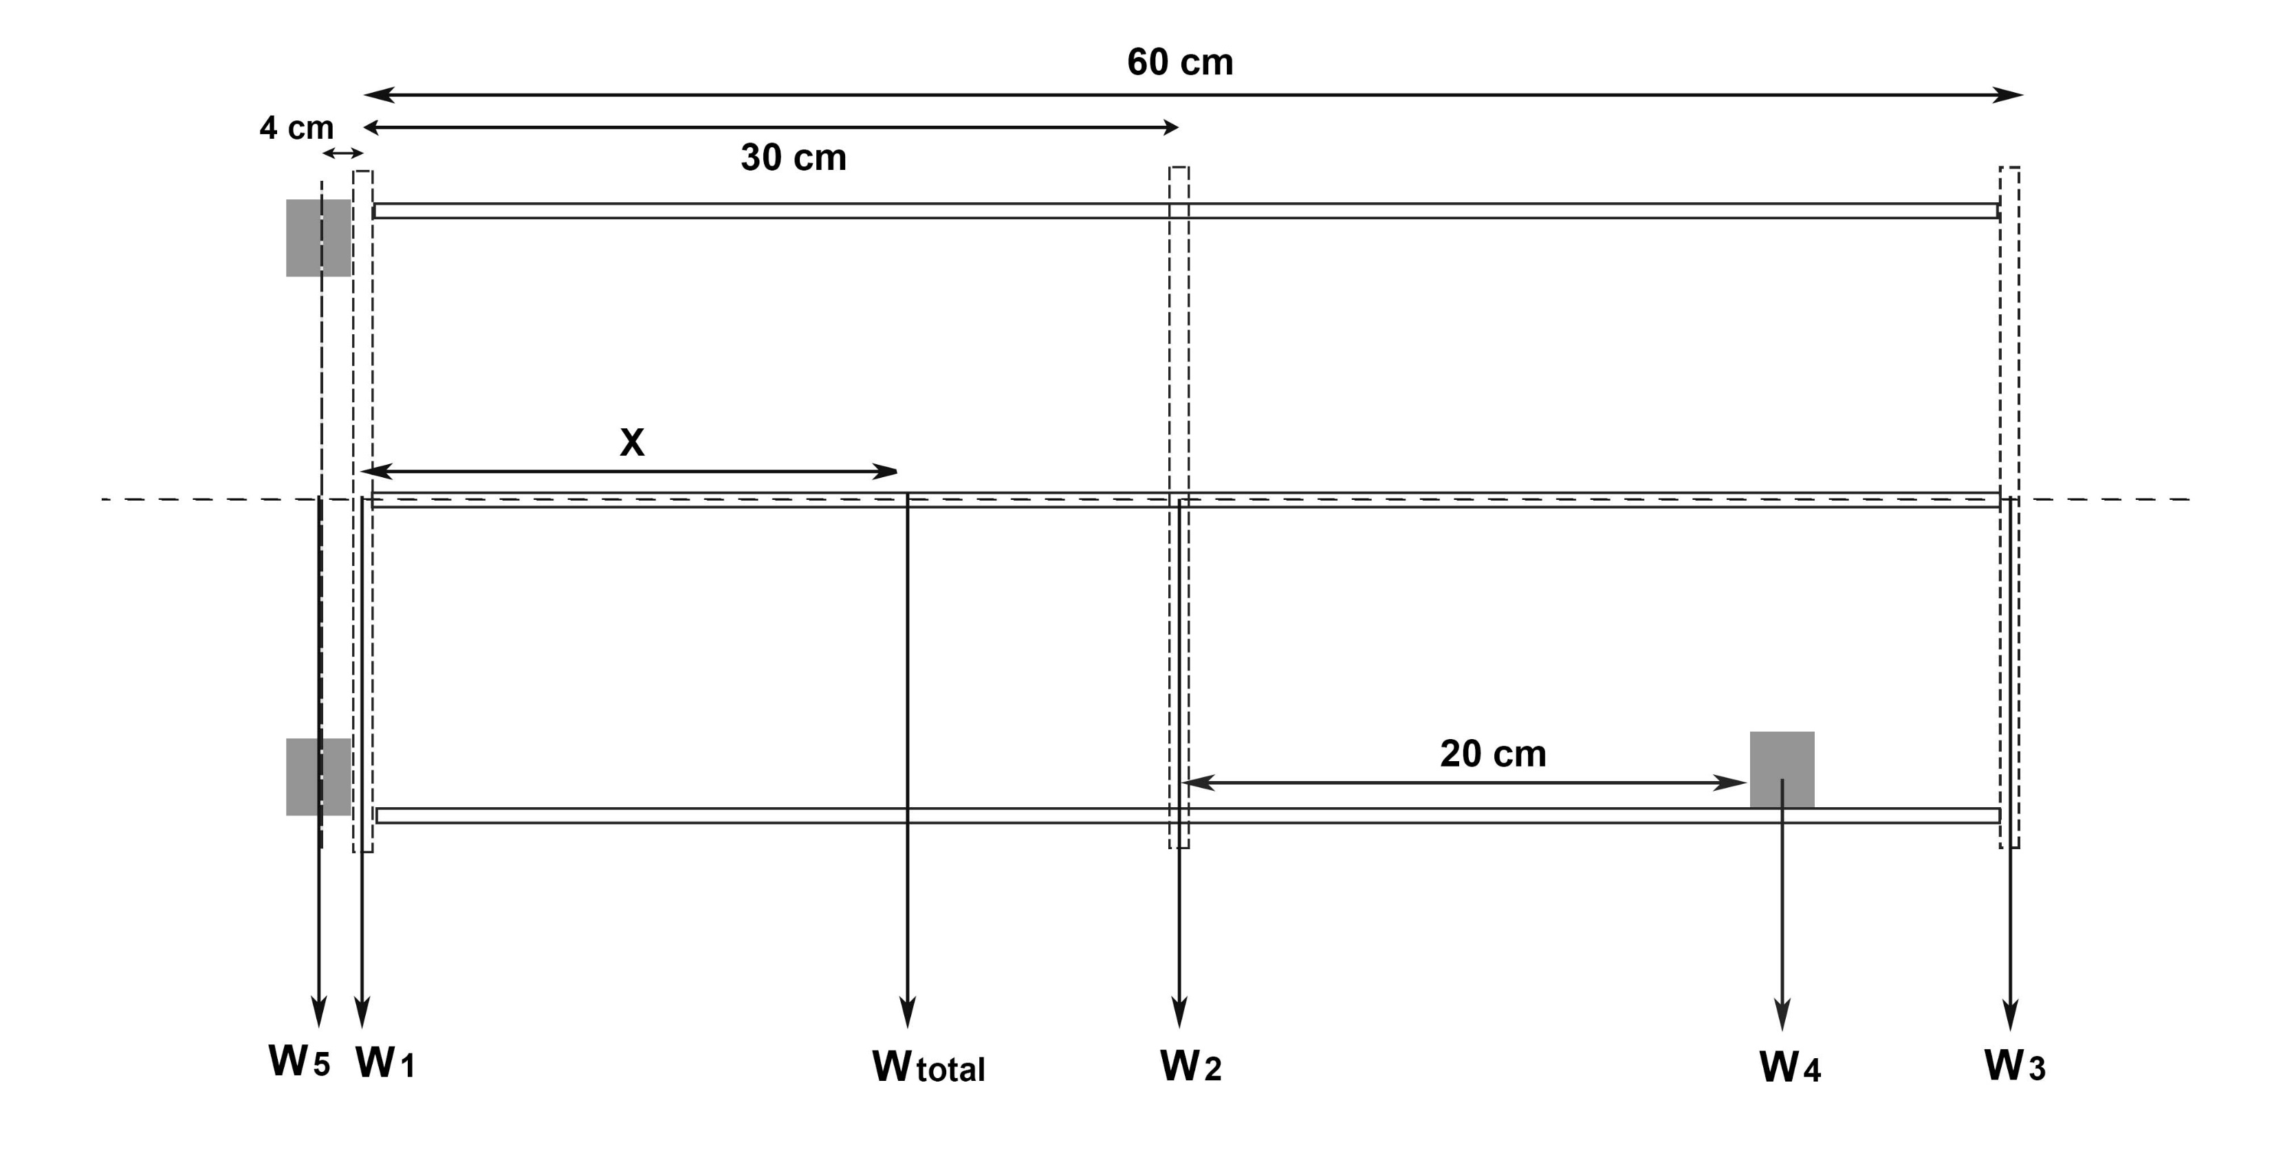
Center of Gravity Calculation
P
W1 – Steel Bottom plate, Power bank, Battery and Other Electronics.
W2 – ACM Board, Treaded rods, Aluminum tubes Jetson Nano and Arduino.
W3 – ACM Board, Aluminum L profile and food.
W4 – Kinect and holding plate
W5 – Motors and wheels.

Slide 9

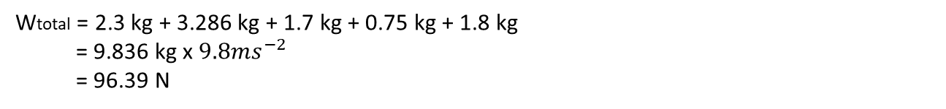
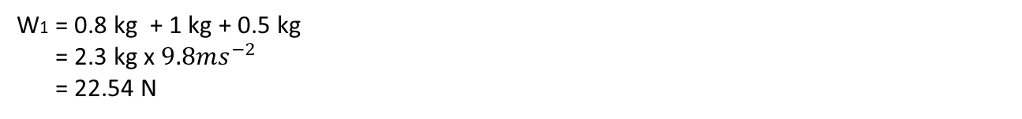
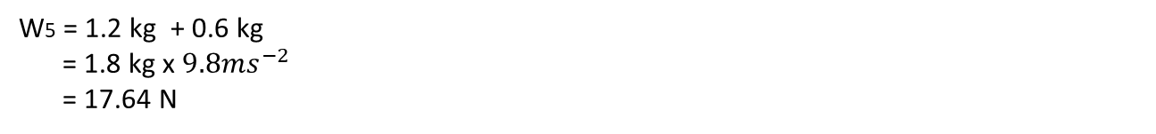
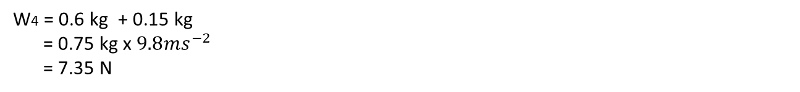
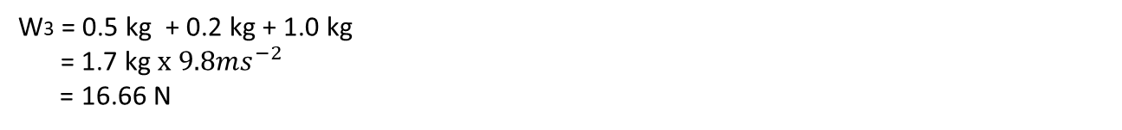
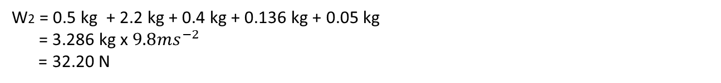
W1 = 0.8 kg + 1 kg + 0.5 kg
= 2.3 kg x $9.8{ms}^{−2}$
= 22.54 N
W2 = 0.5 kg + 2.2 kg + 0.4 kg + 0.136 kg + 0.05 kg
= 3.286 kg x $9.8{ms}^{−2}$
= 32.20 N
W3 = 0.5 kg + 0.2 kg + 1.0 kg
= 1.7 kg $x 9.8{ms}^{−2}$
= 16.66 N
W4 = 0.6 kg + 0.15 kg
= 0.75 kg x $9.8{ms}^{−2}$
= 7.35 N
W5 = 1.2 kg + 0.6 kg
= 1.8 kg x $9.8{ms}^{−2}$
= 17.64 N
Wtotal = 2.3 kg + 3.286 kg + 1.7 kg + 0.75 kg + 1.8 kg
= 9.836 kg x $9.8{ms}^{−2}$
= 96.39 N

Slide 10

P
Considering the moments around point P in clockwise direction,
W1 x 0 + W2 x 0.3 m + W3 x 0.6 m + W4 x 0.5 m - W5 x 0.04m = Wtotal x X
22.54 N x 0 + 32.20 N x 0.3 m + 16.66 N x 0.6 m + 7.35 N x 0.5 m - 17.64 N x 0.04m = 96.39 N x X
9.66 Nm + 9.996 Nm + 3.675 Nm – 0.7 Nm = 96.39 N x X

Slide 11

$\text{X}$ = $\frac{22.631 Nm}{96.39N}$
X = 0.235 m
According to the calculation the Center of Gravity of the robot design is 0.235 m above the bottom plate. It is 9.1cm below the center.

Slide 12
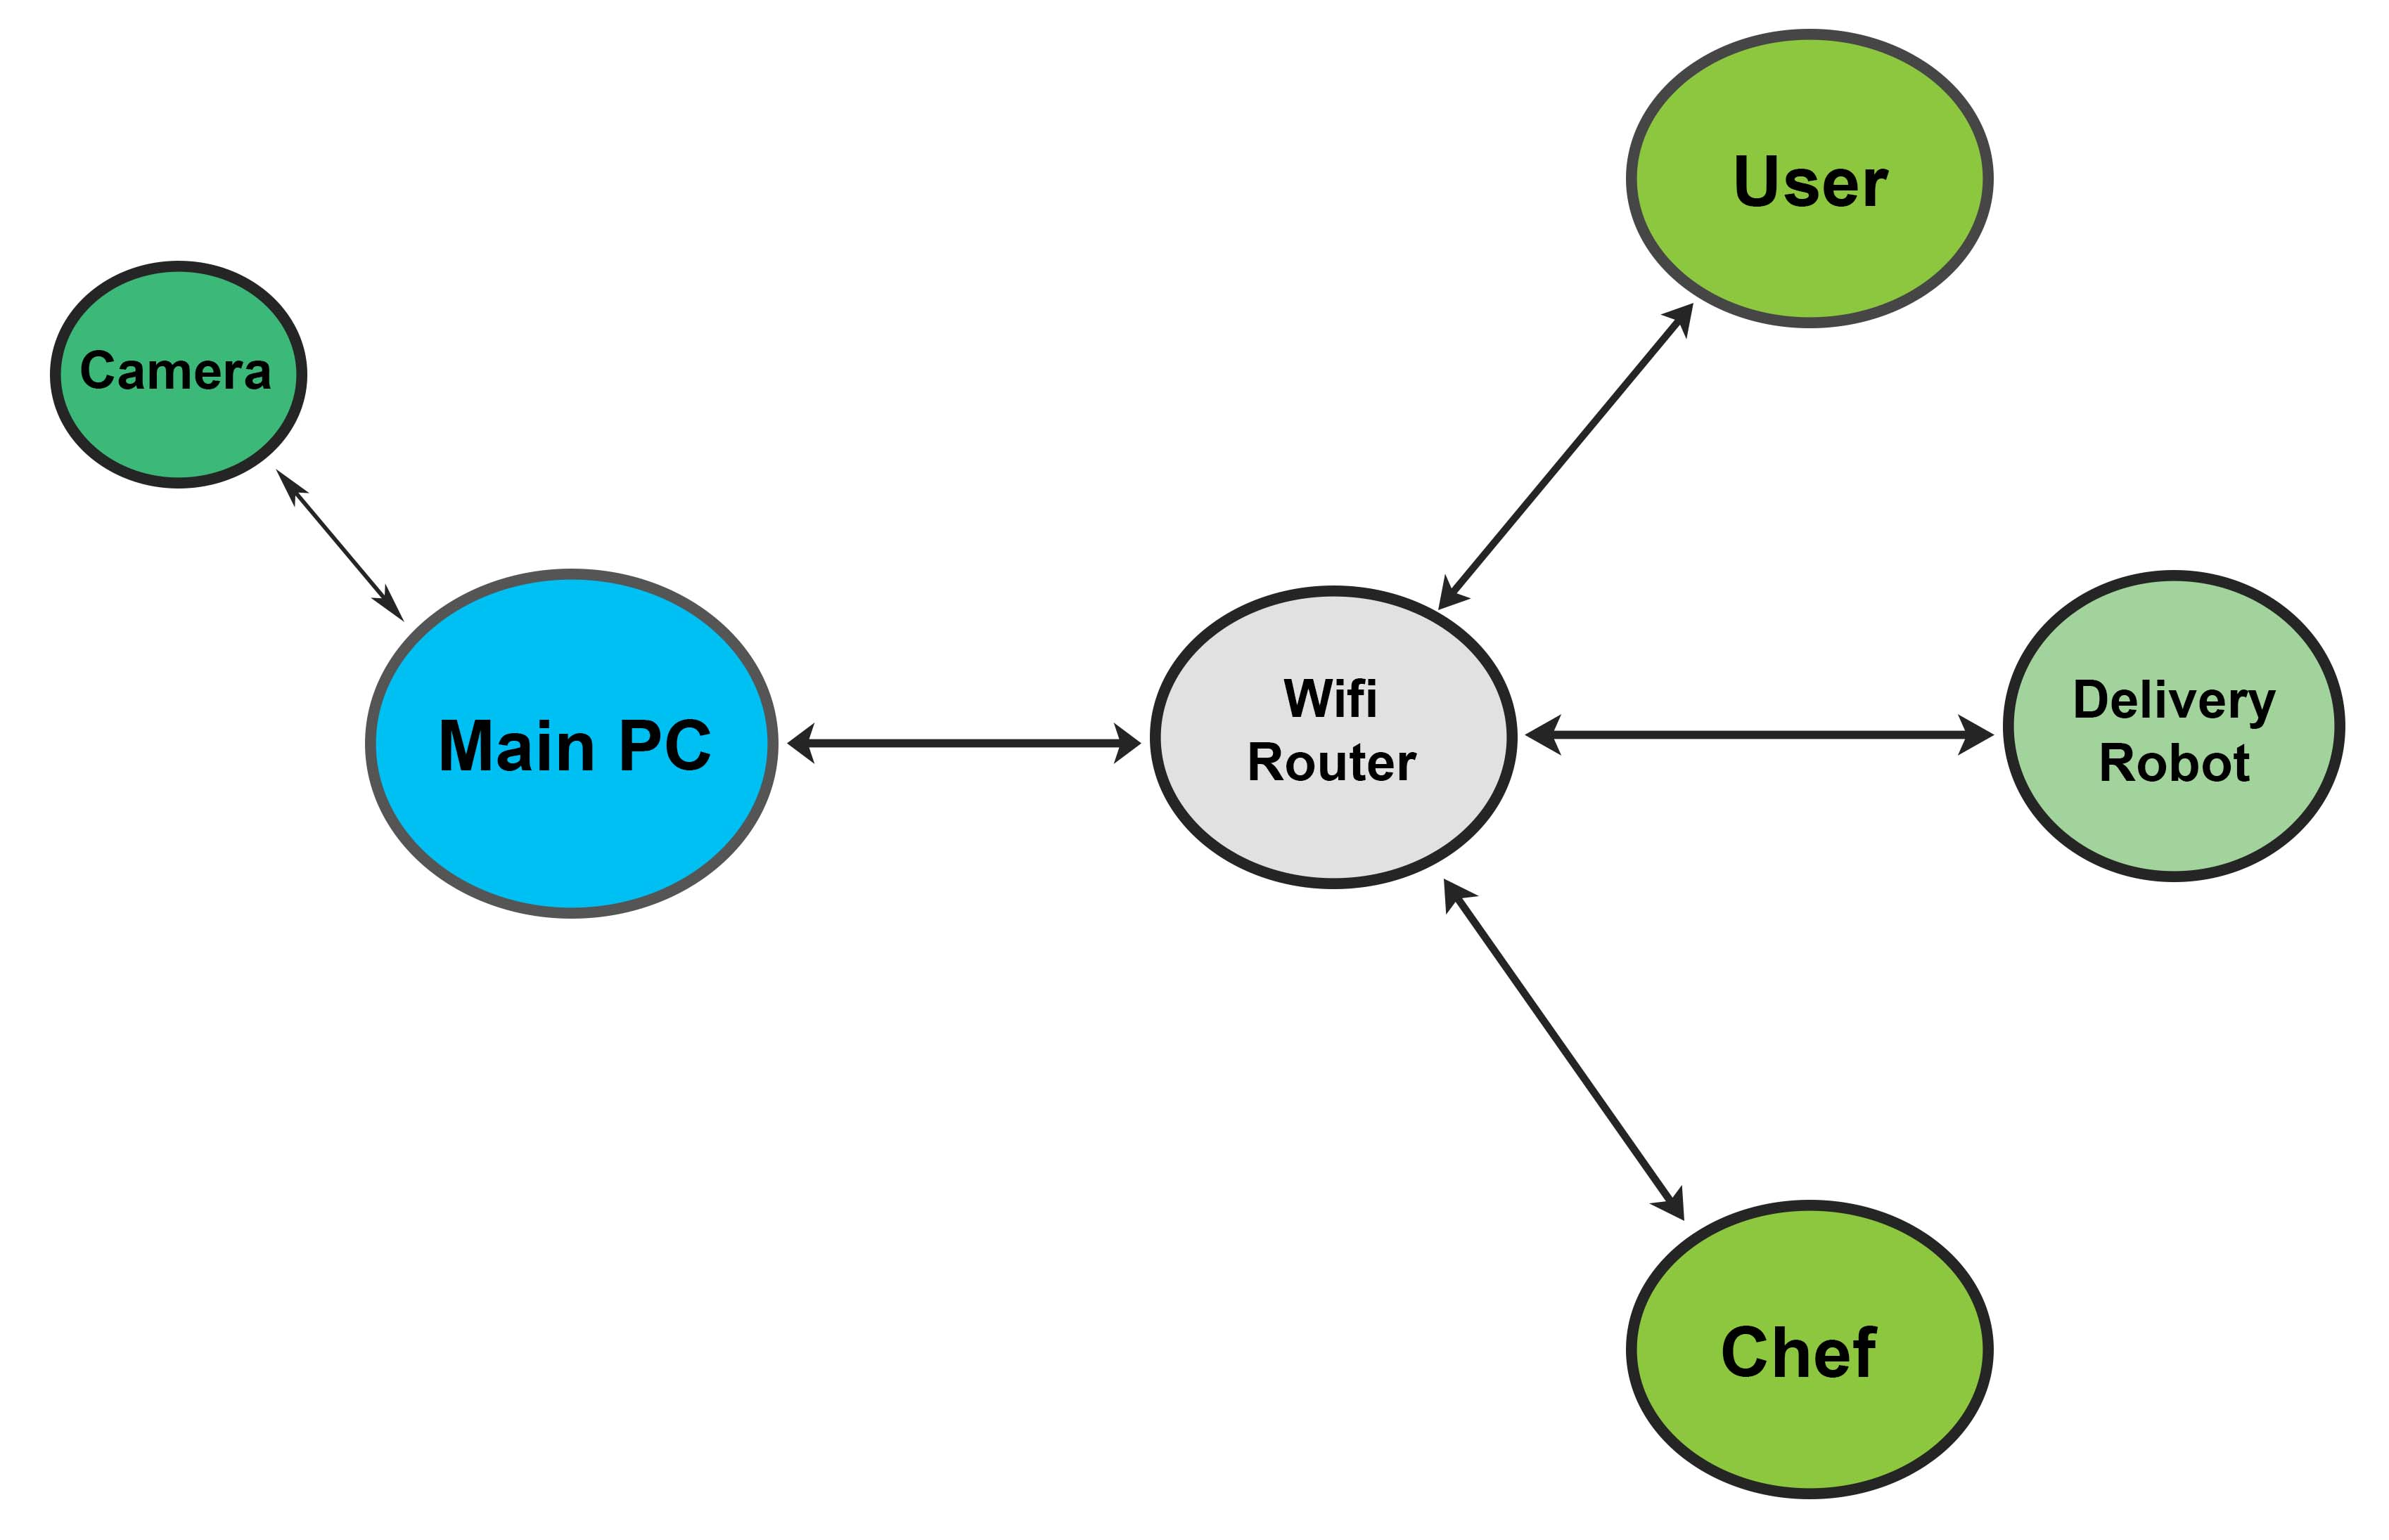
System Diagram
User will put the order through the order management system.
Order will be notified to the chef and chef will place the food on the robot food-placeholder once the order is ready.
Order management system will send a message to the delivery robot to collect the food.
Navigation system will then navigate the robot to the destination table and the customer on the table will take the food.

Slide 13
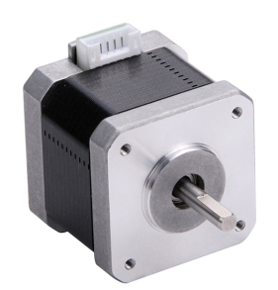
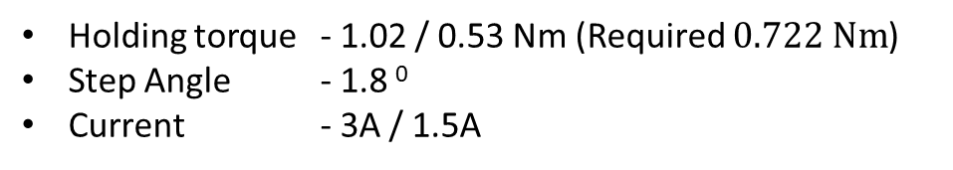
Selection of motors, controllers and other electronics
Selected Motor – NEMA 17/23 Stepper Motor
Holding torque - 1.02 / 0.53 Nm (Required $\text{0.722 }\text{Nm}$)
Step Angle - 1.8 ⁰
Current - 3A / 1.5A

Slide 14
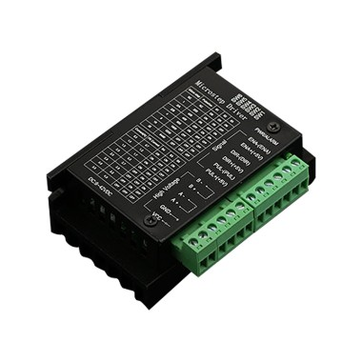
Selection of motors, controllers and other electronics
Selected Motor Driver – TB6600 Stepper Motor Driver
Output Current - up to 4.0A
Micro Step - 1, 2/A, 2/B, 4, 8, 16,32

Slide 15
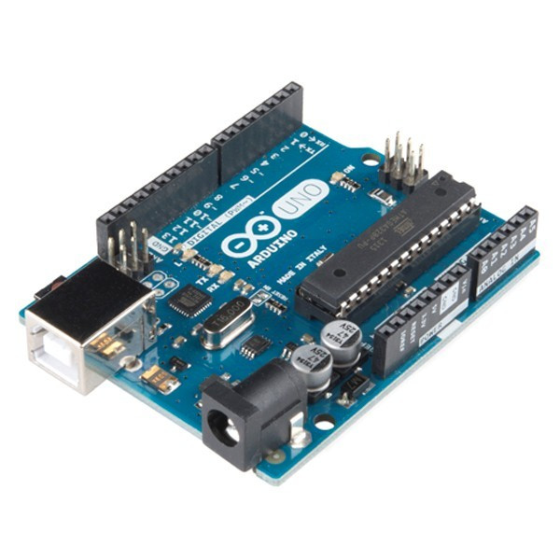
Selection of motors, controllers and other electronics
Selected Controller – Arduino Uno
Digital I/O Pins - 14
Operating Voltage - 5V

Slide 16
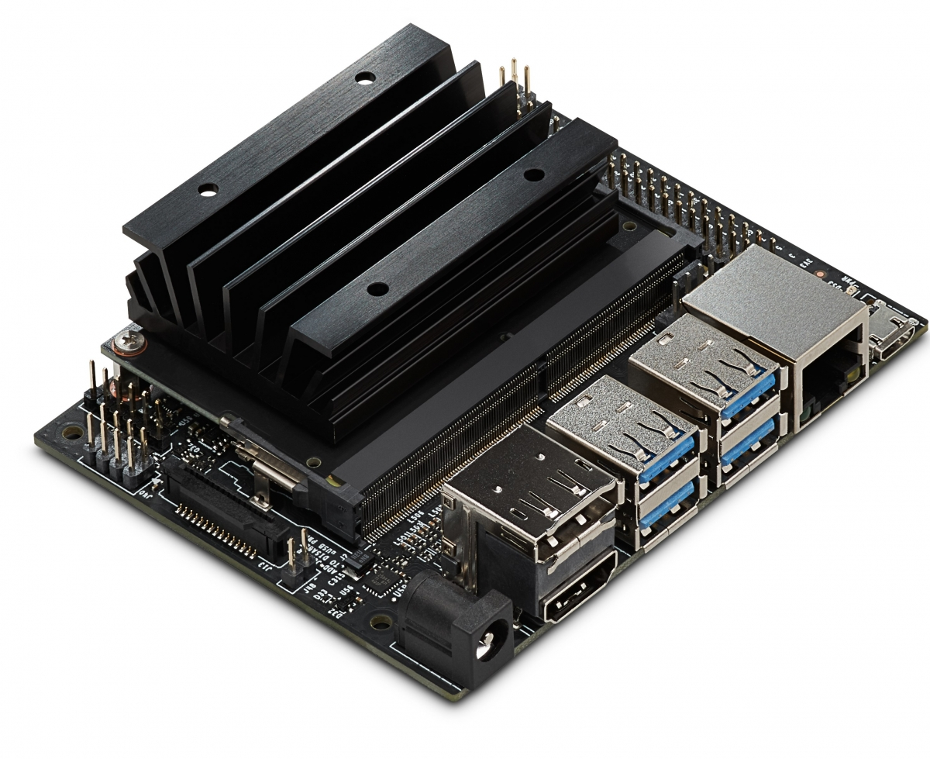
Selection of motors, controllers and other electronics
Selected Single Board Computer – Nvidia Jetson Nano
Quad-core Arm A57 processor @ 1.43
4GB System Memory
4 x USB 3.0 ports, 1x USB 2.0 Micro-B port for power

Slide 17
Thank You

